Slide 1



Kubernetes in Minutes
Provisioning, and configuring
DigitalOcean managed K8S

Slide 2
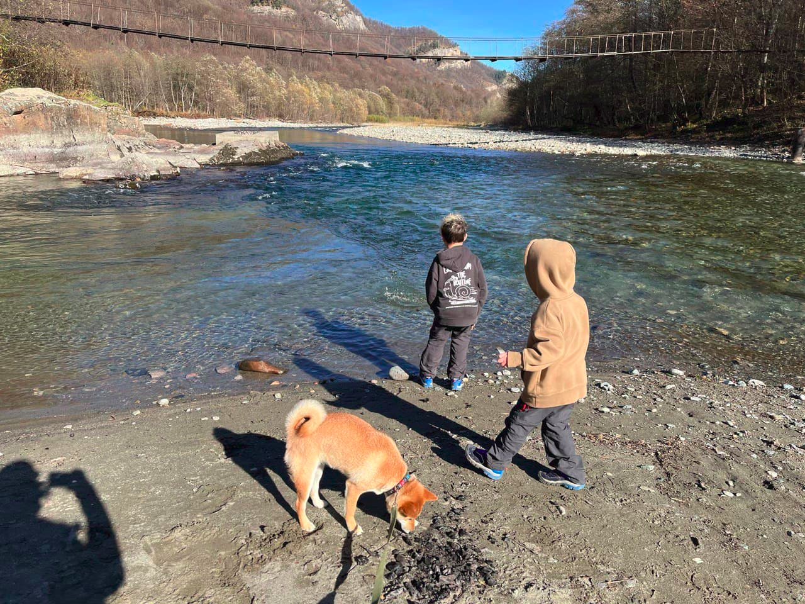

Who is this guy ?
My name is Grigory, but you can call me Greg.
Father of one Shiba-inu, and two reckless boys.
DevOps Team Lead at Naviteq
We provide DevOps services for customers in Israel, and EU

Slide 3
Why K8S ?
Kubernetes became a standard a while ago, there are tons of things done for it, or with it in mind.

Slide 4
Why DigitalOcean ?
You can have cluster up in minutes
Autoscaling is easy to configure
Automated minor version upgrades
1-click apps from marketplace
Traffic pooling. Free amount of traffic is stacked, and shared between nodes in the pool.

Slide 5
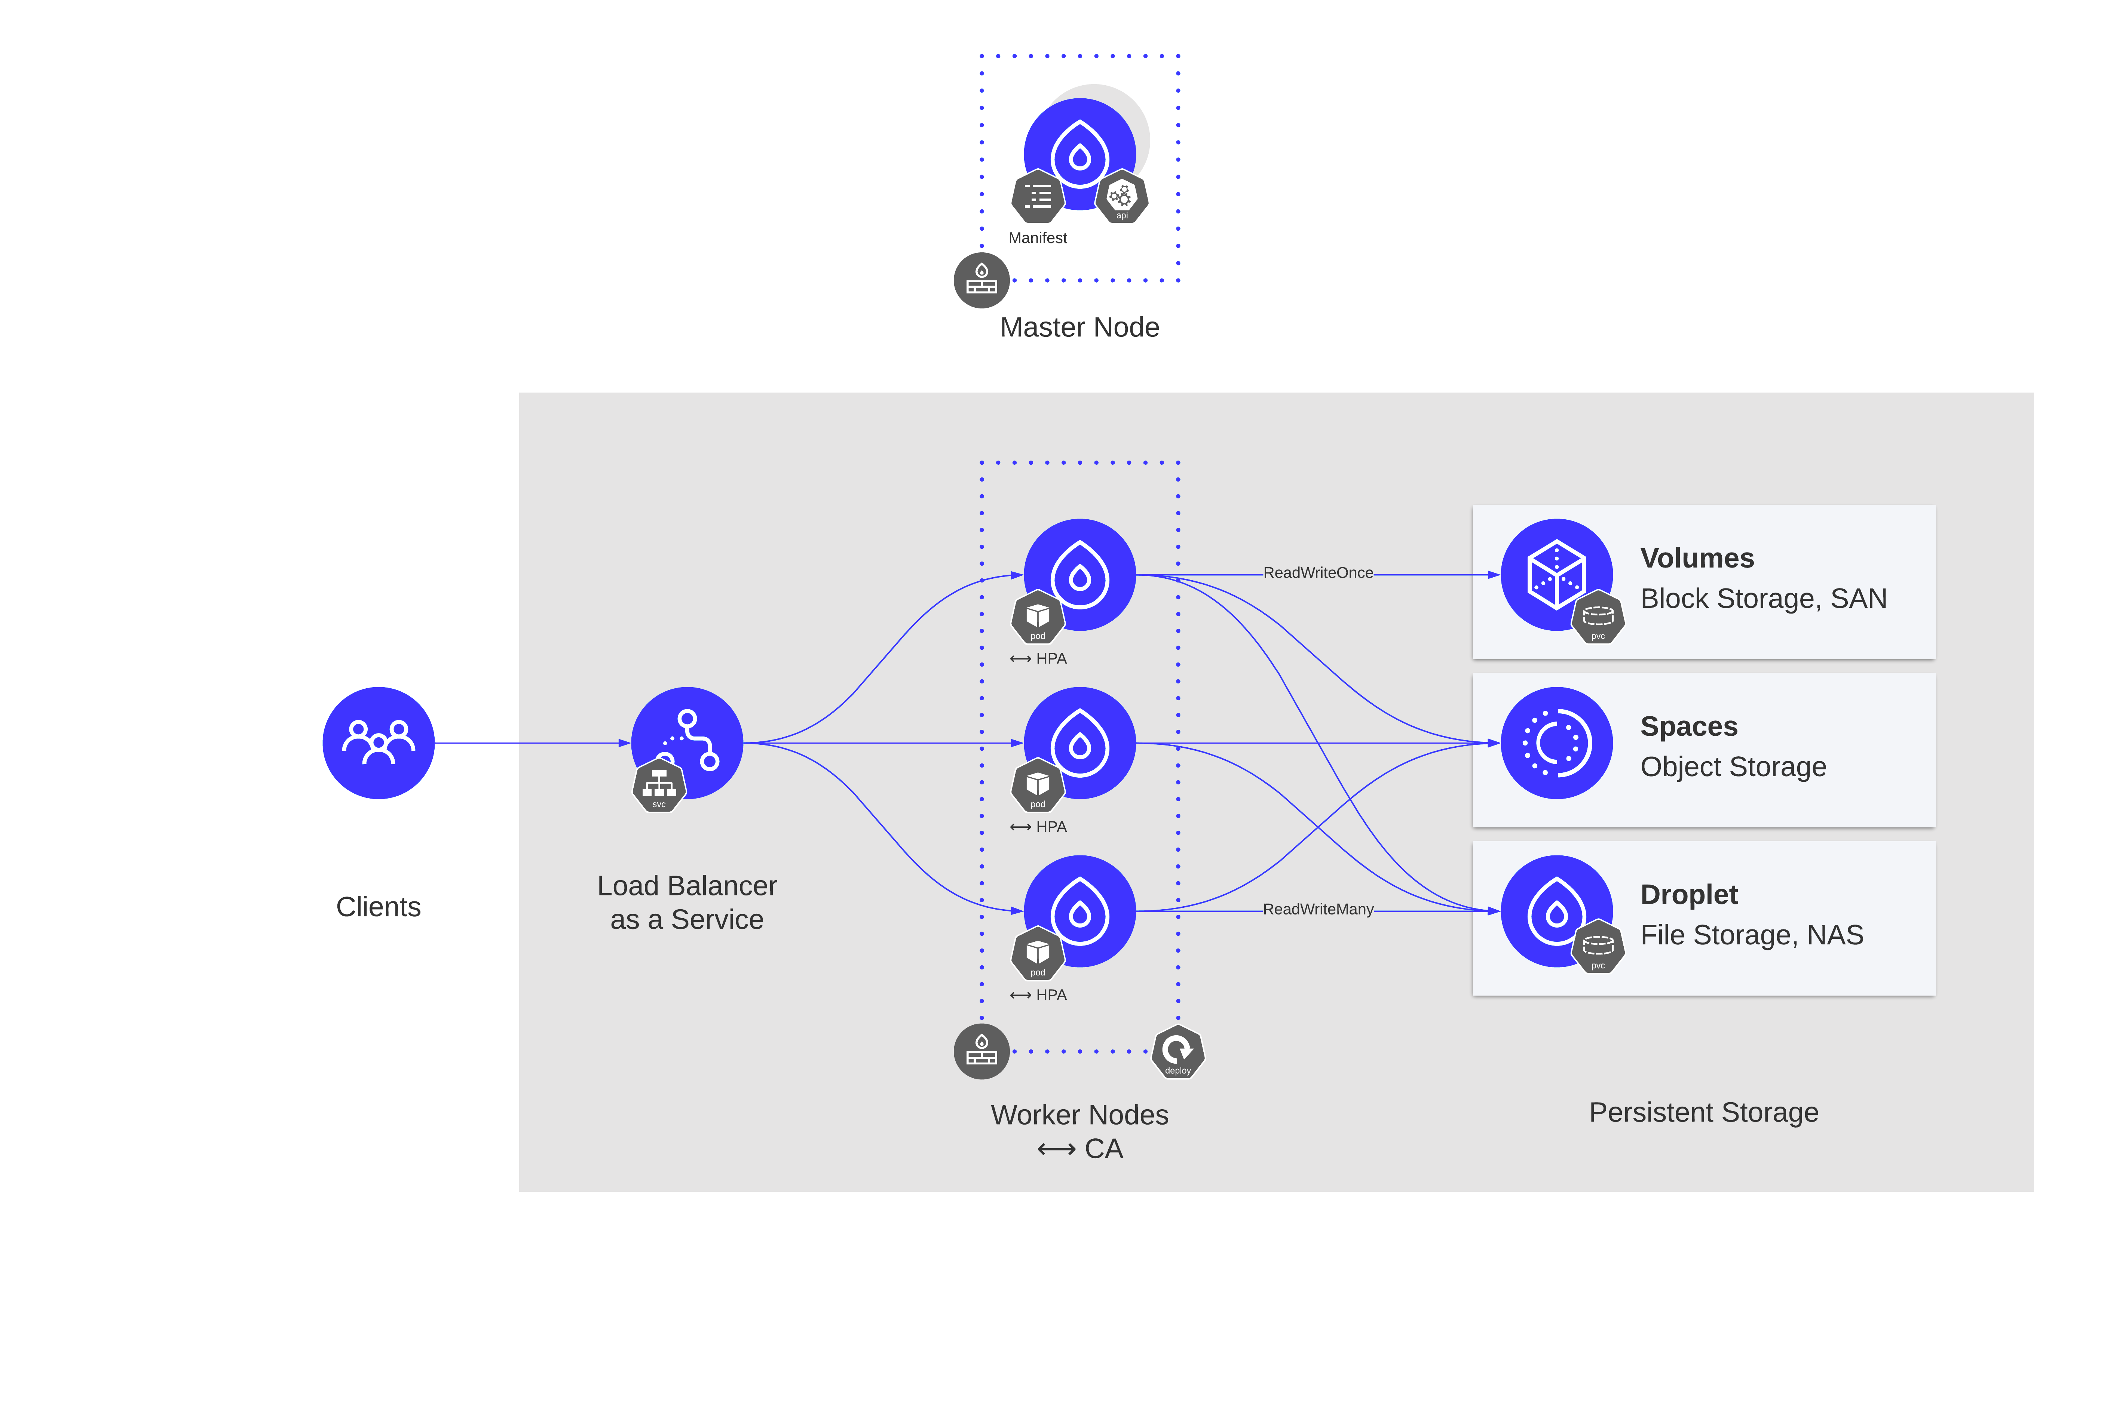
DigitalOcean Managed Kubernetes

Slide 6
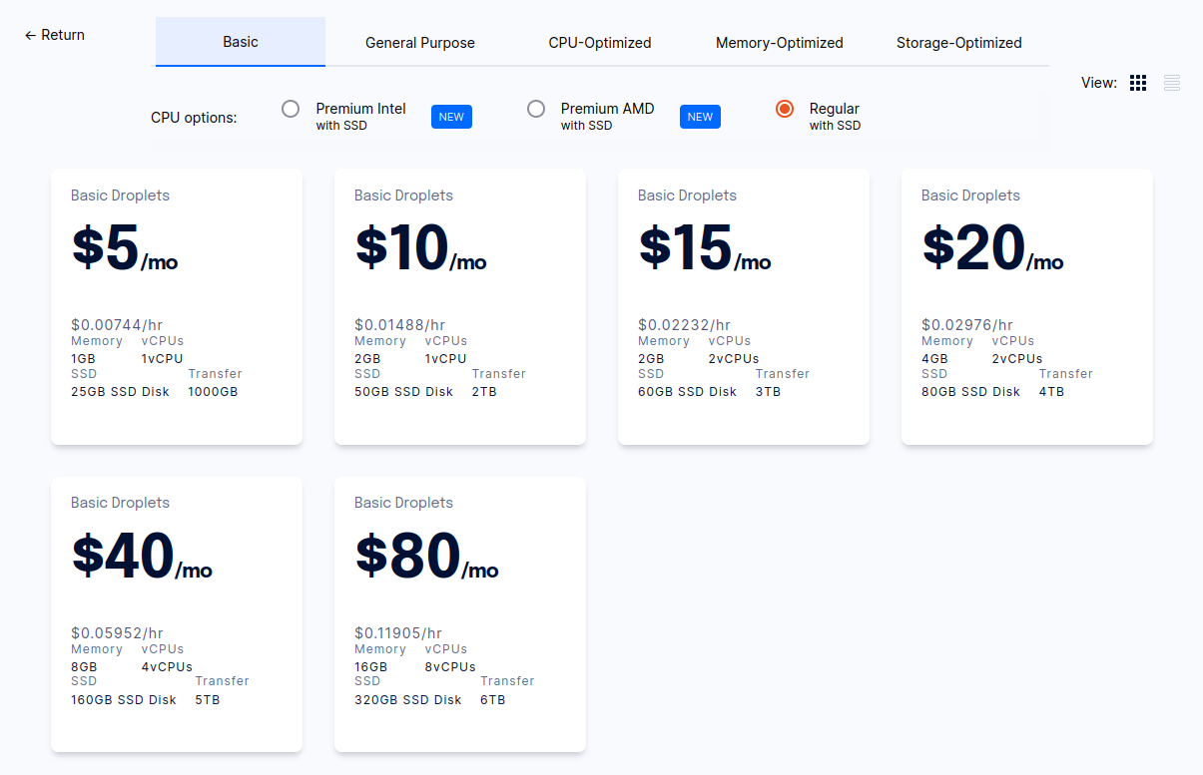
Worker nodes, and pricing
https://www.digitalocean.com/pricing

Slide 7
Tools we are going to use today
terraform
doctl
kubectl
helm

Slide 8
Preparations
We have to generate API key to authenticate, and authorize our requests to DigitalOcean API
https://cloud.digitalocean.com/account/api/

Slide 9
Definition of done:
• DOKS cluster running with multiple nodes, and autoscaling enabled • Demo application deployed, and reachable from the internet over https with valid certificate • As less manual actions as possible, but show diverse ways of interacting with DOKS

Slide 10
Enough slides Hands-on time!

Slide 11

Questions time!

Slide 12
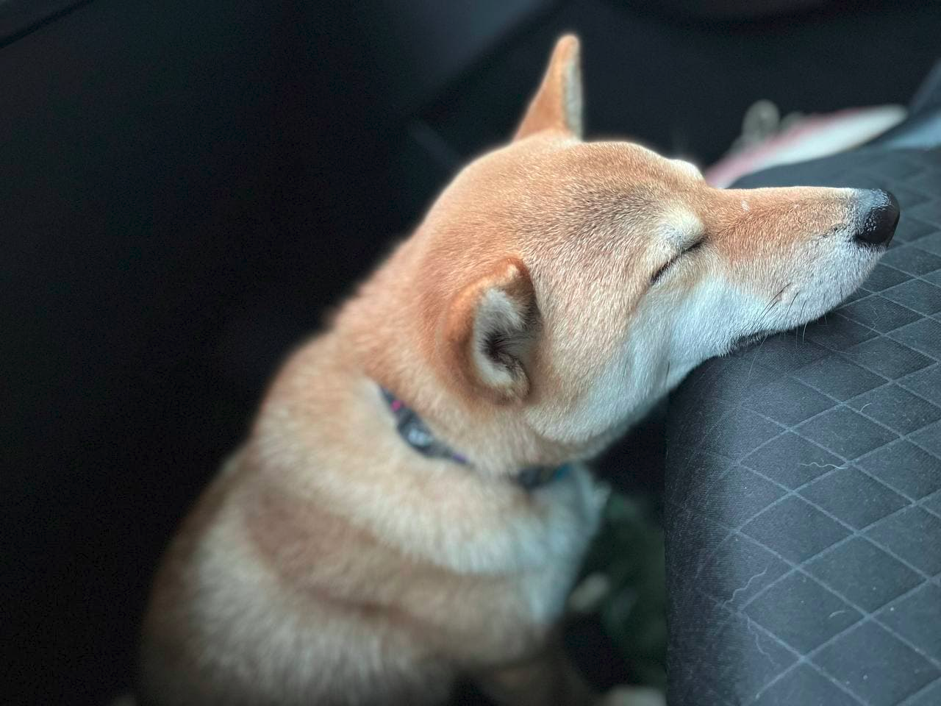
devops@naviteq.io

Slide 13
Something to explore
Cert-manager DNS validation
https://cert-manager.io/docs/configuration/acme/dns01/digitalocean/
ExternalDNS
https://www.digitalocean.com/community/tutorials/how-to-automatically-manage-dns-records-from-digitalocean-kubernetes-using-externaldns

Slide 14
Something to explore
Terraform provider documentation
https://registry.terraform.io/providers/digitalocean/digitalocean/latest/docs/resources/
Detailed manual
https://github.com/digitalocean/Kubernetes-Starter-Kit-Developers

